Slide 1

Radiation
IN ORDER TO UNDERSTAND RADIATION PHYSICS, ATOMIC MODEL HAS TO BE KNOWN WELL

Slide 2
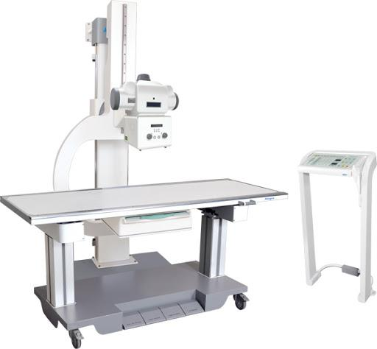
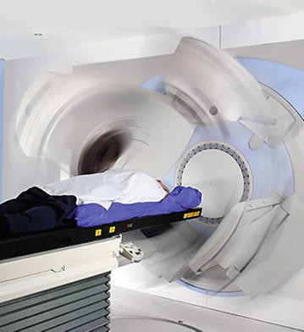
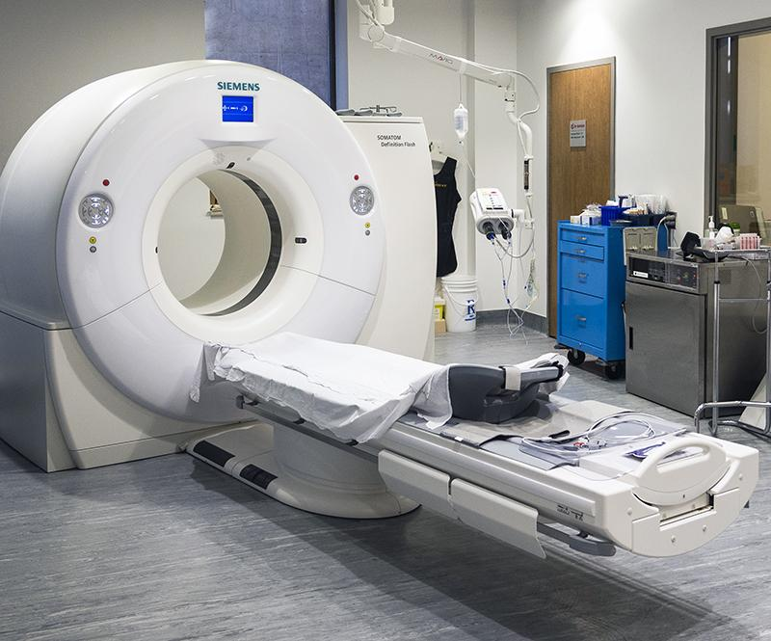

Motivation Radiation is used in our daily life, especially in medical imaging. X-ray Imaging, Computed Tomograpy, Radiotherapy ,Fluoroscopy , ......

Slide 3

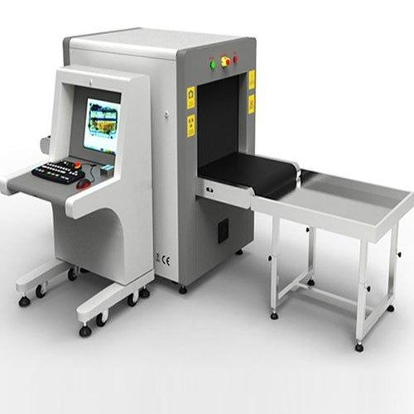
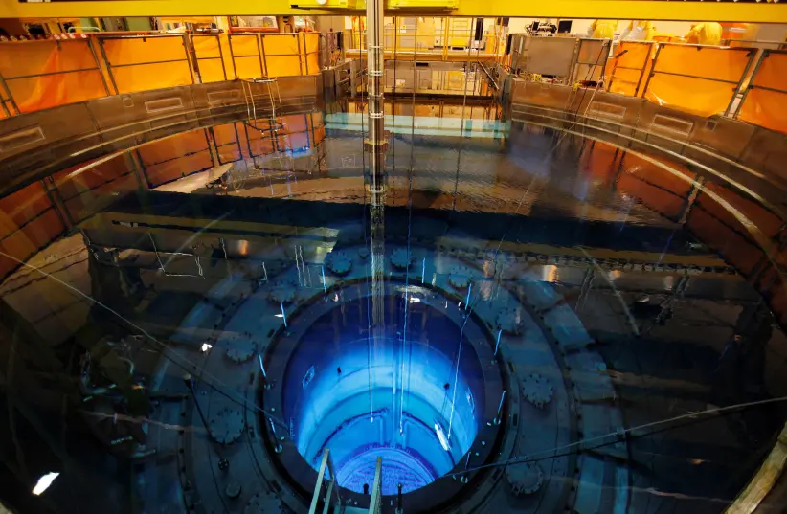

Motivation Radiation has many beneficial uses. Radiation is used for many purposes in industry
Nuclear Power Plant
Measuring density in materials
Measuring the thickness of materials
Detecting smoke
Sterilising medical equipment
Eliminating static electricity
...
...
Nuclear Power Plant inside
Security scanning using X-ray

Slide 4
Learning Objectives
Models of Atom
History of Atom, Radiation and Radioactivity
Nucleus of Atom
Radiation
Elektromagnetic Spectrum
Differences between ionizing and non-ionizing radiation
Differences between radioactivity and radiation

Slide 5
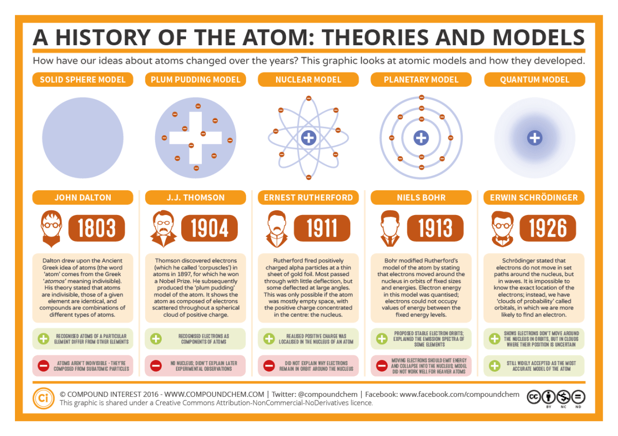
Timeline of Atomic Models

Slide 6
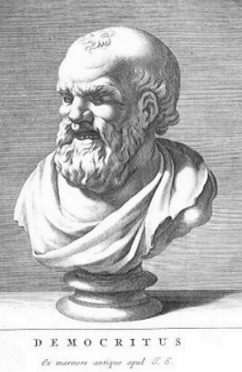
Democritus
Democritus
was the first person talking about the idea of atom
lived about 2500 years ago
wasn’t a scientist
didn’t do any experiment in laboratory to prove his idea
was a philosopher

Slide 7
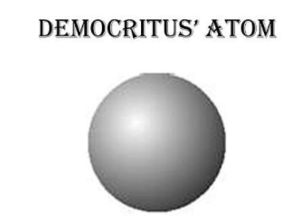
Democritus
Democritus said that
Imagine you have an object (like bread) and you cut it in half,
then you take half of it and you cut it in half again
and go on, go on, go on this idea
Eventually,
You have someting that you can’t cut in half anymore
This particle was called atom by Democritus
Atom means uncuttable

Slide 8
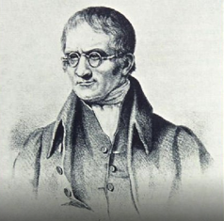
Solid Sphere Model (in 1803, by Dalton)
British chemist John Dalton came up with the first scientific experiments about atom.
Dalton showed that
Matter was made of tiny little particles
This tiny particle was called atom

Slide 9
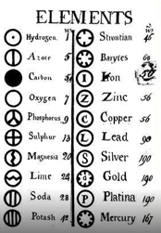
Solid Sphere Model (in 1808, by Dalton)
indivisible =bölünemez
According to Dalton
Atoms are indivisible particles
Atoms can’t be cut them into smaller pieces
Atoms cannot be destroyed in a chemical reaction
Atoms of different element have different chemical properties
Different atom has a different symbol

Slide 10
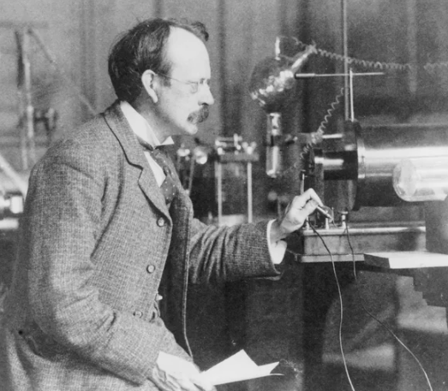
Plum Pudding Model (in 1904, by Thomson )
In the early 1900’s, people’s idea about atoms started to change.
J.J Thomson discovered that
atoms have electrons
electrons are much much smaller than atoms
atoms are not indivisible, because they have electrons. Electrons are much smaller than atom.

Slide 11
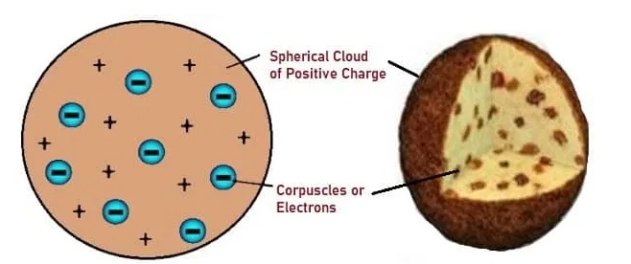
Plum Pudding Model (in 1904, by Thomson )
Thomson thought that
atom is like a plum muffin
Dough in a plum muffin was like a positively charged substance
Plum was like negative electrons
Together the positive and negative charge balanced the each other.
Therefore, the atom was electrically neutral
He called this the plum pudding model

Slide 12
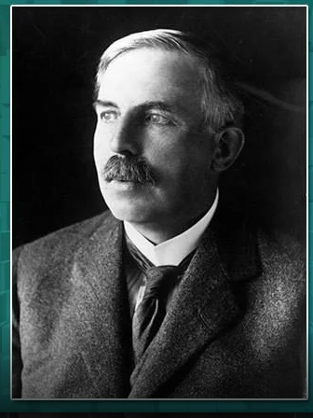
Nuclear model (in 1911 by Rutherford)
In the alpha scattering experiment
Ernest Rutherford discovered that
Atoms had a nucleus.
All the positive charge in an atom was concentrated in it’s center.
Electrons revolved around the center.

Slide 13
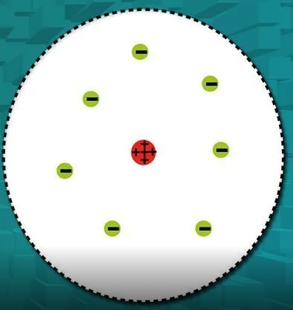
Nuclear model (in 1911 by Rutherford)
JJ Thomson thought the positive charge was all distributed like dough in a muffin
But Rutherford showed that
All this positive charged particle concentrated in the center.
So, we call the nuclear model of atom. Because it has a nucleus.
There are a lot of empty spaces among the nucleus and the electrons of atom.

Slide 14
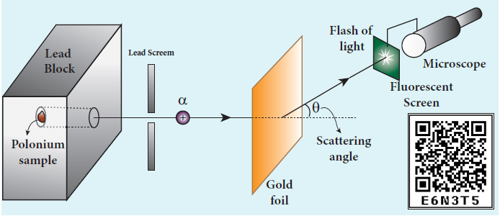
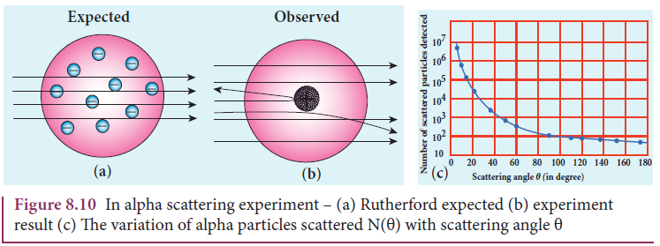
Alpha Scattering Experiment
In alpha scattering experiment,
Rutherford bombarded the alpha particles on metallic thin gold foil.
These particles interact with gold foil.
Rutherford expected the nuclear model to be as seen in figure

Slide 15
Alpha Scattering Experiment
The results of this experiment are that
Most of the alpha particles are un-deflected through the gold foil and go straight.
Some of the alpha particles are deflected through a small angle.
Some of the alpha particles are deflected large angle.
Very few alpha particles return back (back scattered)
Since most alpha particle passed through the gold foil witout any deflection, most of the space inside on atom is empty

Slide 16
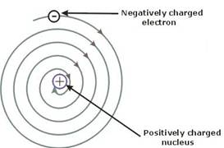
Rutherford couldn't explain
According to the electromagnetic theory of radiation,
an electron moving around the nucleus is an accelerated charge particle. Hence, it should emit radiation energy.
Consequently, its distance from the nucleus will decrease continuously and finally it will fall into the nucleus along a spinal path.
The main problem with Rutherford’s model was that
he couldn't explain why negatively charged electrons remain in orbit when they should instantly fall into the positively charged nucleus.
This problem would be solved by Niels Bohr in 1913

Slide 17
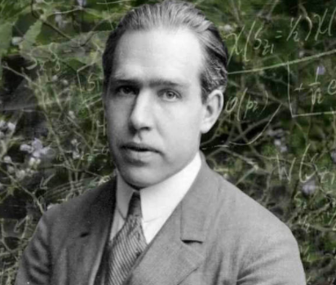
Planetary model (in 1913, by Bohr)
In 1913, Danish physicist Neils Bohr came up with his model of ato m
He said that
there is a nucleus in the middle (just like Rutherford said)
electrons revolve around the nucleus regularly, not randomly
He placed each electron in a specific energy and specific distance

Slide 18
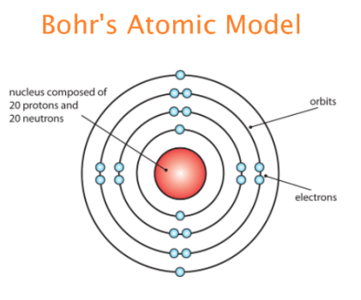
Planetary model (in 1913, by Bohr)
According to Bohr’s atomic model
Electrons move in definite orbits around the nucleus like planets revolve around the sun
These orbits are located at certain distances from the nucleus

Slide 19
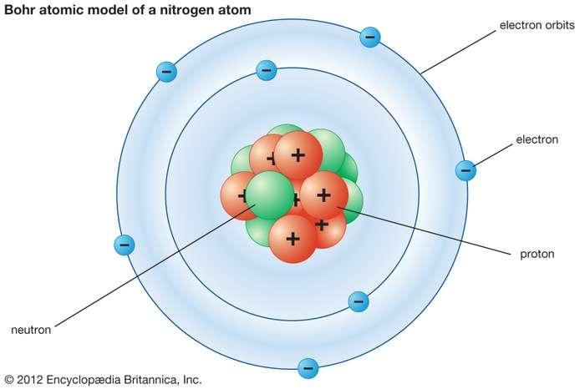
Bohr’s atomic model is based on four postulates: Bohr solved the problem that Rutherford could not explain
Postulate 1: Electrons revolve about the nucleus in well-defined, allowed orbits.
Postulate 2: While in orbit, the electron does not lose any energy (no energy loss while electron is in allowed orbit).
Postulate 3: The angular momentum of the electron in an allowed orbit is quantized (quantization of angular momentum).
Postulate 4: An atom emits radiation only when an electron makes a transition from one orbit to another

Slide 20
History of atom and radiation (together)
In 1803 Dalton’s model of atom
In 1895 X-rays were discovered by Wilhelm Conrad Rontgen (Radiation)
In 1896 Radioactivity discovered by Henri Becquerel
In 1898 Radium and Polonium discovered by Marie and Pierre Curie (Radioactivity)
In 1904 Thomson’s model of atom
In 1911 Rutherford’s model of atom
In 1913 Bohr’s model of atom
In 1919 Discovery of the proton by Rutherford
In 1932 Discovery of the neutron by Chadwick

Slide 21
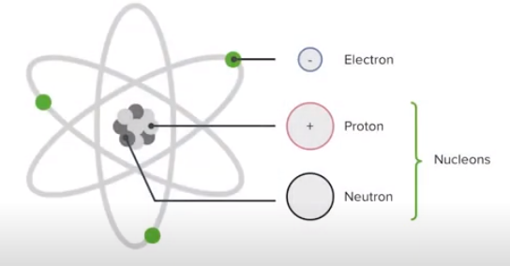
Atomic Nucleus
Rutherford’s alpha scattering experiment played an imported role to understand the structure of the atom and the nucleus.
There are proton and neutron in the atomic nucleus
Proton and neutron both are called nucleons
Not only atoms have proton and neutron, but also they have electrons.
Electrons revolve around the nucleus in orbit.

Slide 22
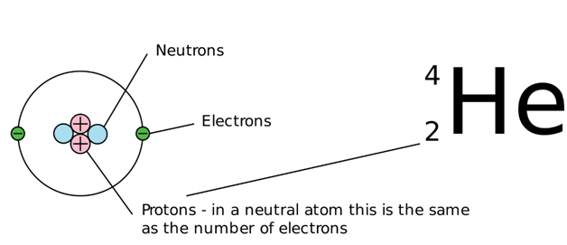
Atomic Number
The atomic number is the number of proton in the nucleus of an atom
Number of protons in nucleus defines the identity of that nucleus.
Helium is defined as the element which has 2 protons in it’s nucleus

Slide 23
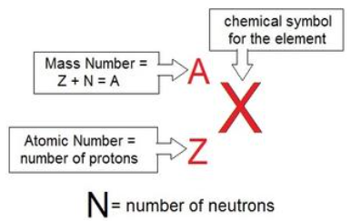
Composition of nucleus
The number of protons in the nucleus is called the atomic number (Z).
The number of neutrons in the nucleus is called neutron number (N).
The total number of neutrons and protons in the nucleus is called the mass number (A).
A = Z+N
The number of neutrons doesn’t change the identity of the element

Slide 24
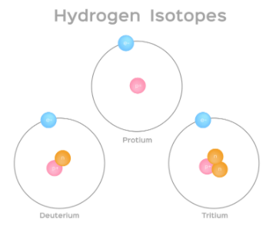
Isotop
In nature, some nucleus have same number of protons but different number of neutrons.
These kinds of atoms are called isotopes.
Hydrogen has three isotopes and they are called (hydrogen), (deuterium),and (tritium).
All the three nucleus have one proton and
hydrogen has no neutron,
deuterium has 1 neutron
tritium has 2 neutrons

Slide 25
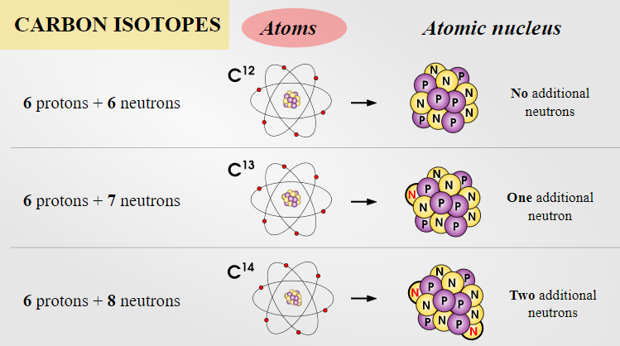
Isotop
Isotopes are atoms of the same element having same atomic number Z, but different mass number A.
The total number of nucleus (proton + neutrons) can vary in same atom.
But in same atom, number of proton can not be different

Slide 26
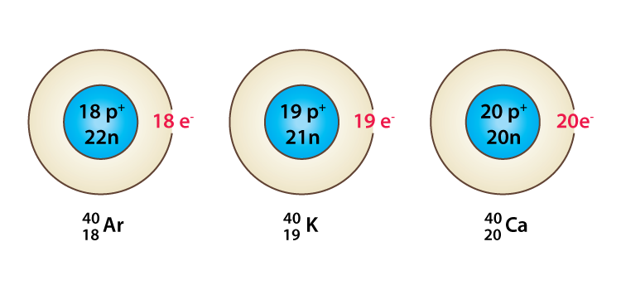
Isobars
Isobars are the atoms of different elements having the same mass number A, but different atomic number Z.
Isobars are the atoms of different chemical element which have the same number of nucleon.
Ar-40, K-40 and Ca-40 have same mass number and different atomic number.
Isobars are chemically different elements.
They have different physical and chemical properties.

Slide 27
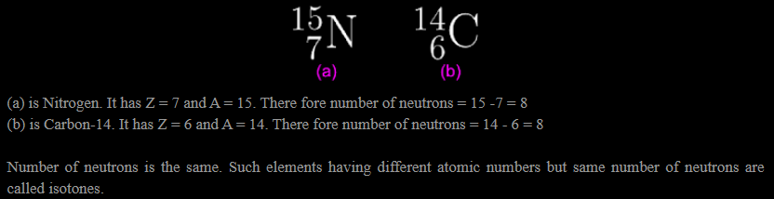
Isotones
Isotones are the atoms of different elements
Isotones atoms have the same number of neutrons.

Slide 28
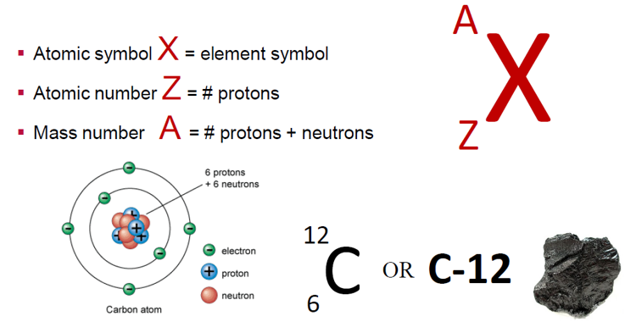
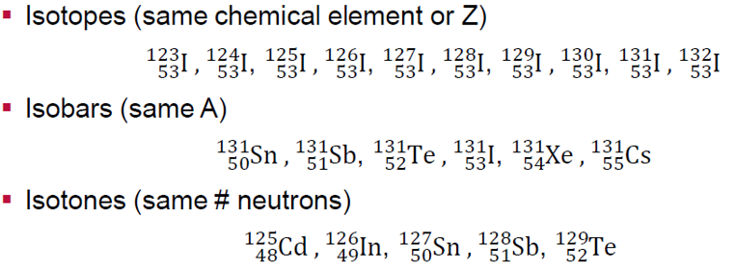
Rewiev Nomeclacture

